Slide 1
“From a Doorstep Economy to a Green Economy: Responsibility, Consumption and Natural Resources in the futures of Cuba".
Eng.Yociel Marrero Baez,Msc.
Antonio Nuñez Jimenez Foundation for Nature and Humanity

Slide 2
How to have prosperity without poverty, to have well-being without a large income gap, and to protect the environment while achieving a high level of development”

Slide 3
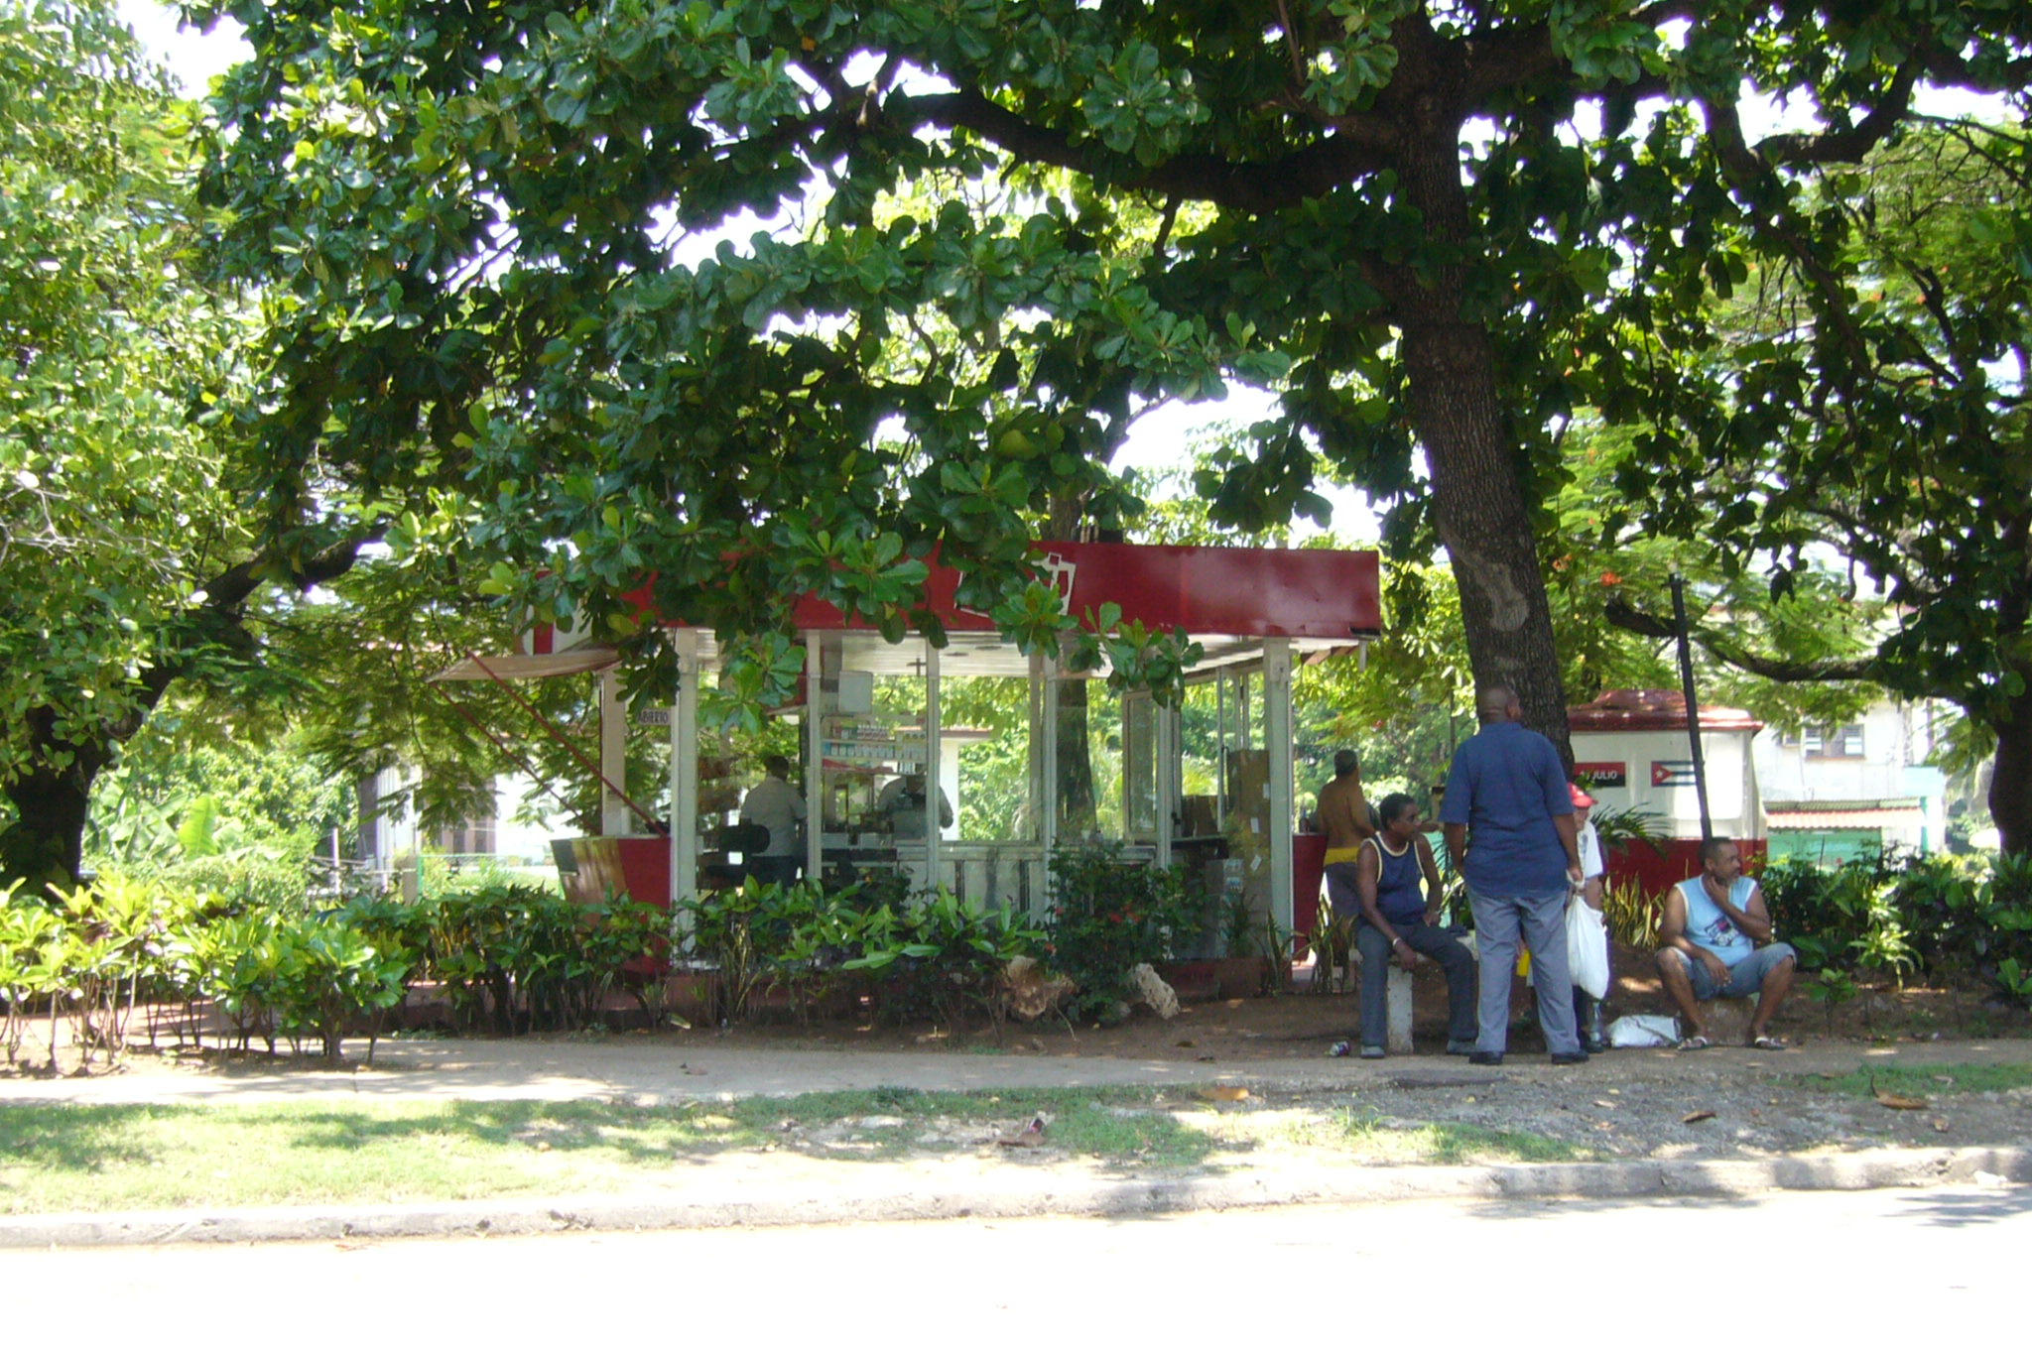
Cuba’s centralized economic model is exhausted. The average annual growth rate has fallen from 9% from 2004-2007 to 2.1% from 2008-2016; the fiscal deficit reached US$ 10 billion in 2008; the terms of trade deficit increased by 35% in 2008 and another 15% in 2009;

Slide 4
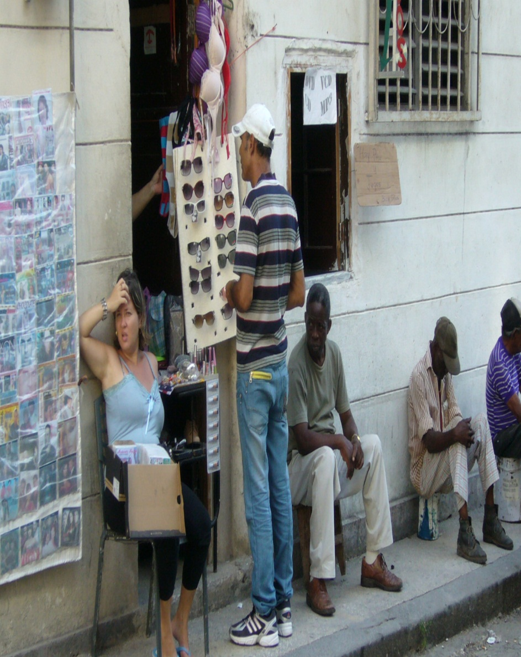
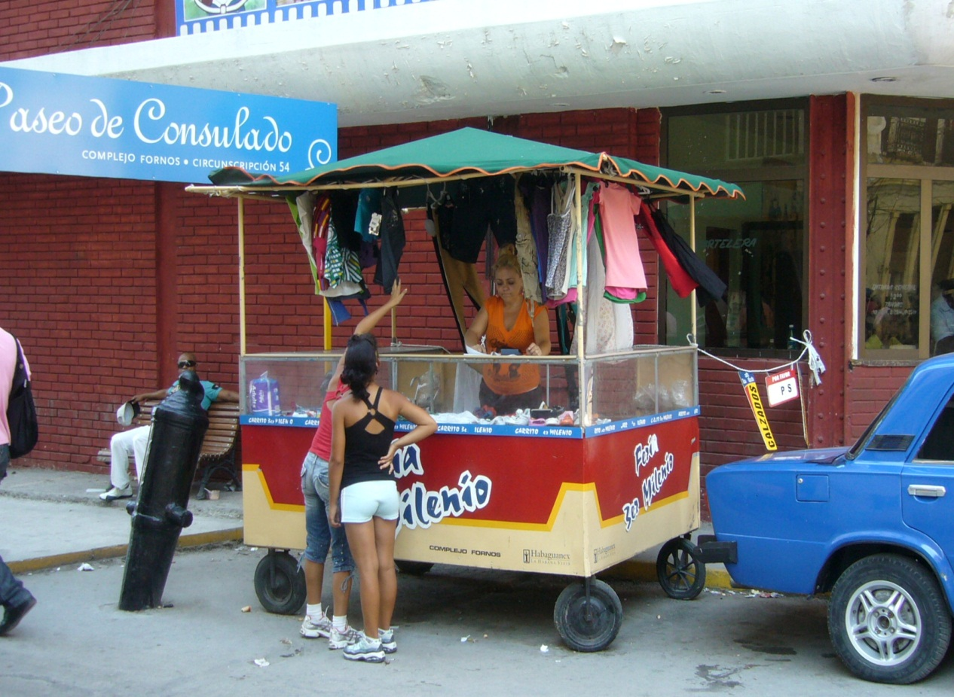
A culture of entrepreneurship is growing rapidly: from 100,000 self-employed workers in 2008, there are now around 500,000.
80,000 new licences have been granted to private enterprises

Slide 5
With minimal foreign influence, global market influence, or established consumerist ideology, the country is,
economically speaking, as close to a blank slate as one can get.
In comparison to countries entrenched in neoliberal economic systems,
this is an ideal situation for the development of alternative or “new”
economies. Bearing this in mind, how Cuba develops – under what values, using what means, and to reach what ends – becomes the pivotal question.

Slide 6
In the matter of what type of economic system to emulate, Cuba may have fewer options than appear at first glance.
To start, Cuba has very limited natural resources. Globally, we have reached a consensus that we cannot sustain the unfettered global production and consumption patterns of current without also experiencing dire environmental effects. The case of Cuba’s development likewise cannot afford to push aside the environmental implications of short-sighted economic decisions.
Cuba´s natural resources must be used responsibly to ensure their viability and existence for future generations. Specifically, potable water and domestic energy sources are very constrained – this will have large implications on the practicality of certain industries (e.g. tourism, water- and energy-intensive manufacturing, etc.) in Cuba.

Slide 7
In Cuba, the focus that the government places on social equality and the provision of social programs would undoubtedly clash with an unregulated market economy due to its tendency to create unequally-distributed wealth and opportunity.
Respect for its environment and its natural resources will therefore be crucial to the creation of a sustainable economy.
Instead of relying on any pre-existing economic system, the country will need to innovate.

Slide 8
IS it POSSIBLE TO develop the ECONOMY with responsible COMSUPTION IN CUBA?

Slide 9
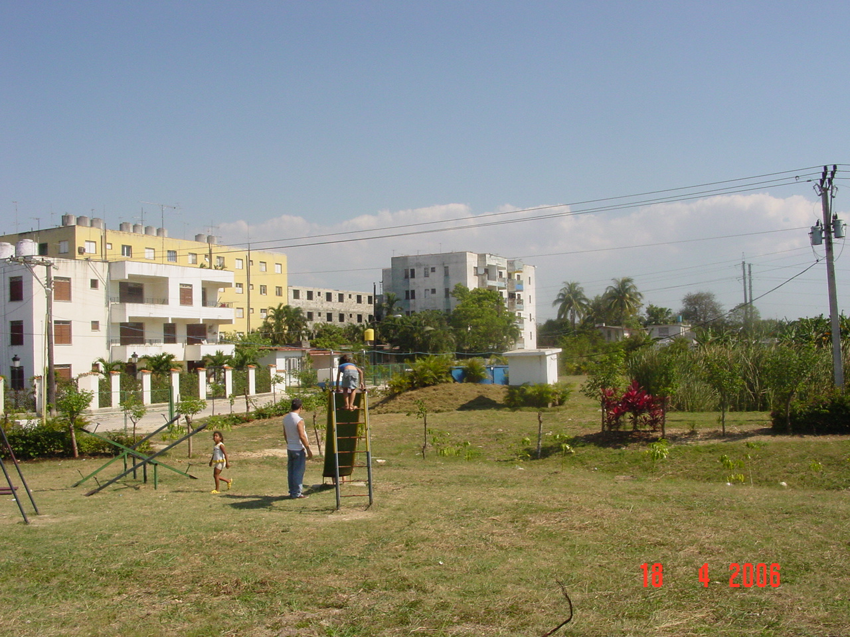
Is the only possibility to implement the idea of a possible harmonious interaction between the Economic-financial, Productive and Mercantile systems
With the
Biological, Humans and Social systems
looking at
A real protection of the natural resources and the exercise of the socioeconomic development on a safe and durable bases.

Slide 10
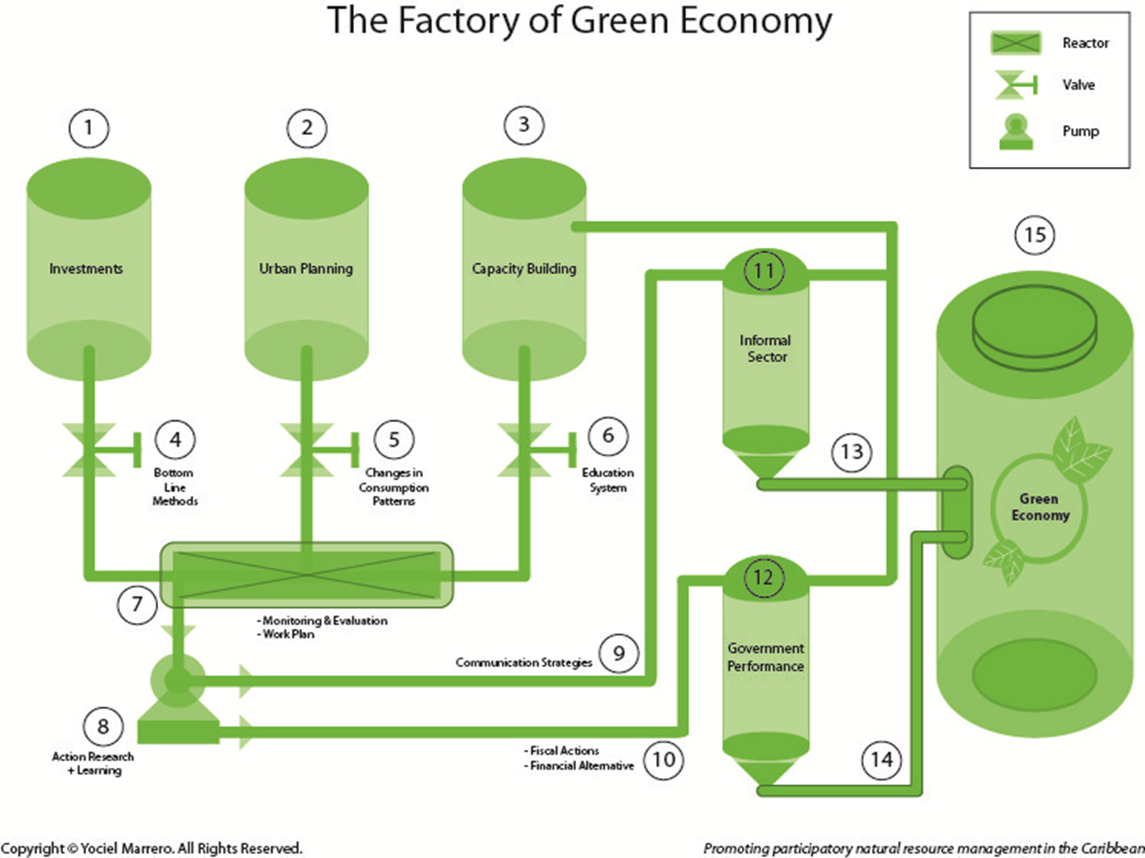

Slide 11
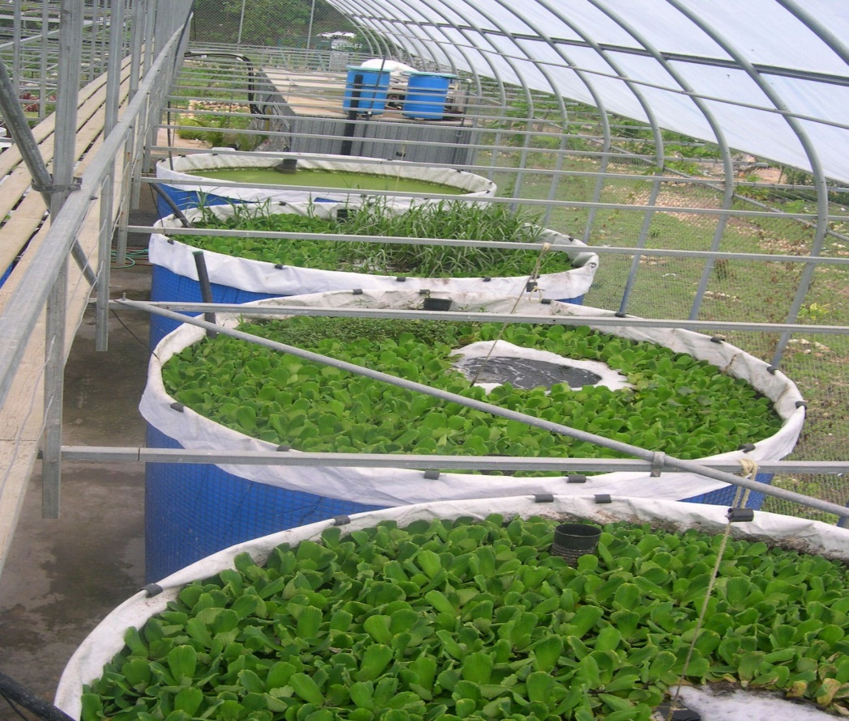
Recognize the imminent need to assume also within the "Economic Policies" recommended, essential aspects such as:
Energy models and the use of fuels.
The form of mining to reach those levels of development in the short term.
The participation of soil and water in the rebirth of agriculture.
The forms of property on which this dream development will stand.
These ideas would allow to establish the optimal proportions of interaction between the market, foreign investment, the tax system and the forms of ownership,
with
Expected patterns of consumption, production processes, social behavior, environmental costs, local economies, energy autonomy and appropriate financial mechanisms

Slide 12
Actions:
promote local exchange systems to increase the amount of goods and services consumed by self-employed households.
create financial mechanisms that support community-based structures of production and consumption.
promote energy independence and other actions that can spur the growth of “eco-neighbourhoods” in Havana and other cities and support local green economic development.
support an orderly transition from self-employment to small and medium enterprise: diversify the types of legal ownership and build capacities in green economy.
transform production processes and working cultures.
reform energy policies.
expand the scope of the tax system to ensure a sustainable development pathway rather than simply maintain the operations of the State.
Challenges:
Renovating the economy without creating massive inequalities.
Creating a development model that features equity, efficiency, and low-carbon energy.
Prevention of lawlessness and corruption in the opening of the economy .

Slide 13
The moment to introduce elements of a green economy into public policies is now, while Cuba is in the process of transforming its economic model. Every problem can now become an opportunity. Cuba’s transition is being closely watched by the big economies, and its emigrant communities, in the North and; we have the need and the responsibility to do things right.

Slide 14
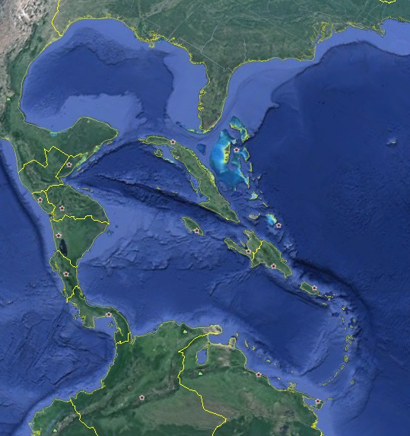
Cuba today is at a crossroads, and must find its own direction. The solutions for our problems cannot be found in Nash or Stiglitz. That is our challenge. We can only achieve economic growth while protecting the environment by investing in the future.
That will require putting in place mechanisms that, while changing the patterns of socio-economic and socio-political inclusion, also train people in responsible patterns of consumption. The aim should be to achieve a society that strengthens and valorises, through inclusion in national accounts, social services as well as ecosystem services, and protects nature and biodiversity through an integrated socio-economic approach.

Slide 15
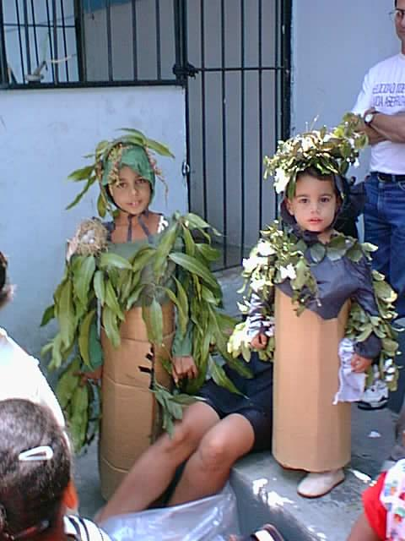
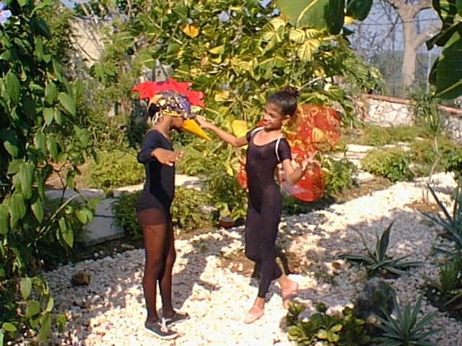
We have to work looking at the analogies,
not at the differences

Slide 16
